Slide 1

Business recommendation for any state
Tanay Singh

Slide 2
Why tourism is important
Creates demand and boosts economy
Tourism industry value chain meets & spreads demand across industries & boosts more economic activities.
Tourism increases consumption
Travelling is good for the soul

Slide 3
Business Problem
People who are interested in opening a restaurant, lodging, transport services, or any other similar businesses which fall within the tourism industry. This also recommends travelers' tourist venues to be visited in a given state of a country.

Slide 4
Data acquisition, preparation and cleaning
The Wikipedia page https://en.wikipedia.org/wiki/List_of_district s_in_India scraped to obtain all the districts of India.
Geopy API used to obtain latitude and longitude of the respective districts.
Removed any missing values present in the dataset
The dataset consists of a single Dataframe with 9 columns.
The final dataset contains 719 rows which includes 36 states.

Slide 5
EDA

Slide 6
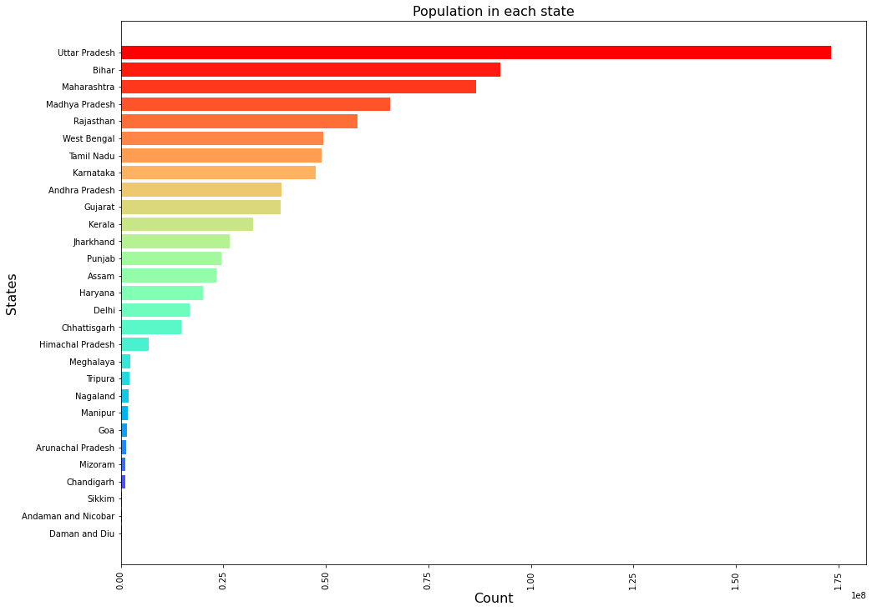
A breakdown of the states and their population density

Slide 7
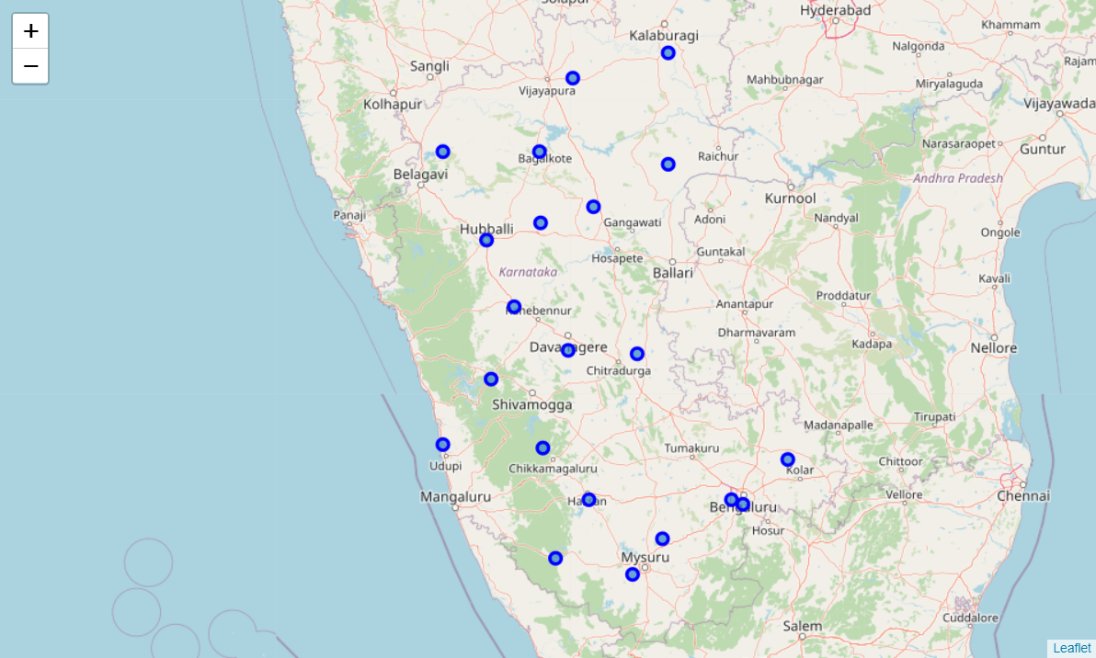
Tourist venues in and about (50KM radius)

Slide 8
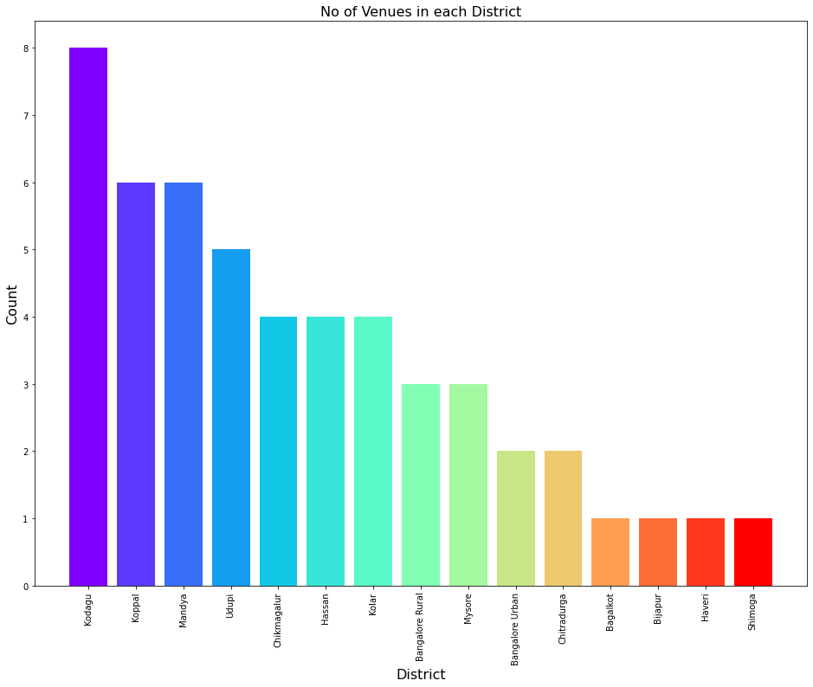
Venues according to the districts

Slide 9
Further steps
Perform one-hot encoding to obtain famous tourist spots in each district.
Use the venues obtained to find the best business that could be established in the locality.
Use K-means algorithm to cluster the business categories obtained.

Slide 10
K means clustering

Slide 11
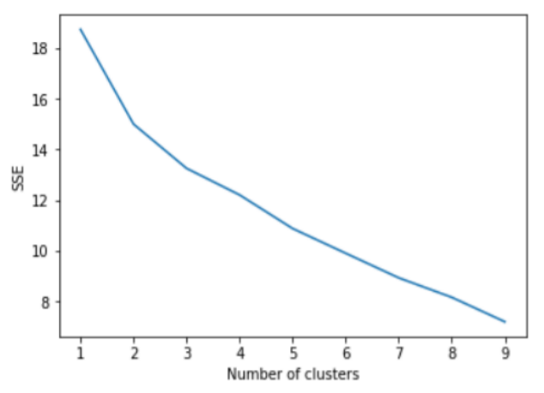
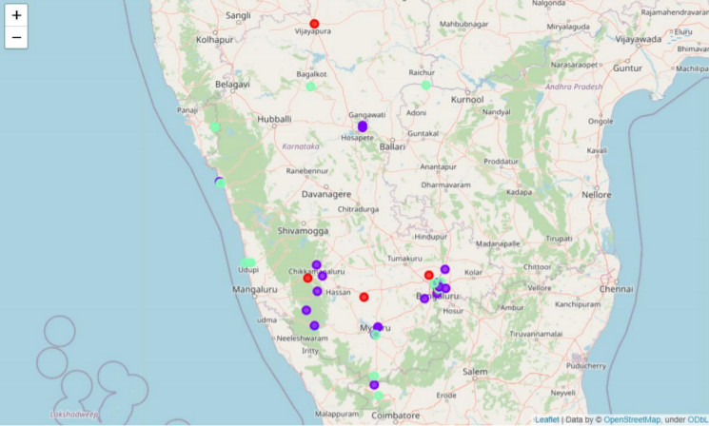
We will choose 3 clusters after performing the elbow method
The colors purple, green, and red represents cluster 0, 1, and 2 respectively.

Slide 12
Conclusion
The results show that the most common business in cluster one at the respective venues are Indian Restaurants.
So Indian Restaurants are popular in these tourist venues and opening up a similar one can attract many tourists.
Whereas in cluster two the most sought business is the Hotel, Seafood Restaurants, and Cafeterias.
The green clusters at the seaside clearly indicate that opening a seafood restaurant would help a person make the best use of the opportunity.
Finally, in cluster three Fast Food/Vegetarian Restaurants have been given a top priority.

